Slide 1

Analysis of Mechanical Properties of Crumpled Graphene: A Molecular Dynamics Approach
by
MD. FARHAN – 1710035
and
MD. SHAHED HOSSAIN SOHAN - 1710043
under the supervision of
DR. MD. ASHIQUR RAHMAN
Professor, Dept. of Mechanical Engineering Bangladesh University of Engineering & Technology

Slide 2


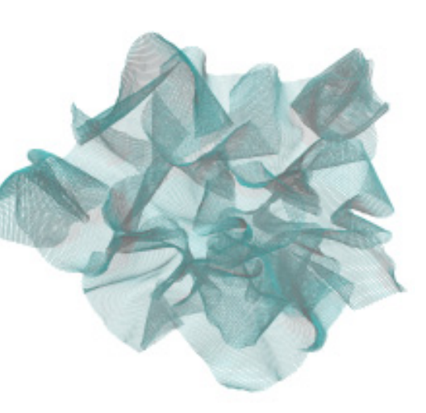
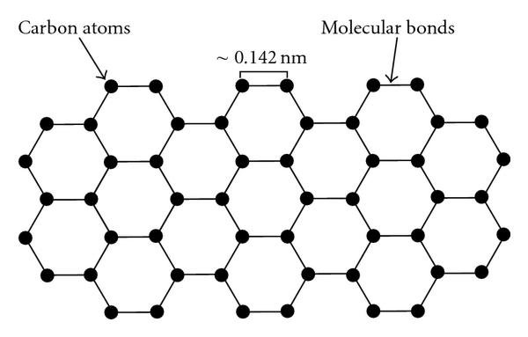
BACKGROUND
Graphene
Flexible, strong, high elastic modulus
Crumpled Graphene
Large specific surface areas, improved conductivity, higher specific capacitance.
(a)
(b)
Figure 01: Atomistic schematic of (a) Graphene[1] and
(b) Crumpled Graphene[2].
ME 400

Slide 3

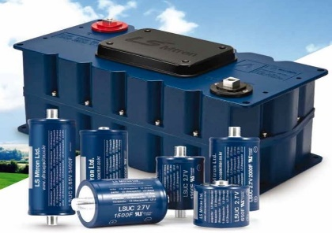
MOTIVATION
Application of Crumpled Graphene
Energy Storage
Electronics & Sensors
Catalysis
Biomedical application
Source: Internet.

Slide 4
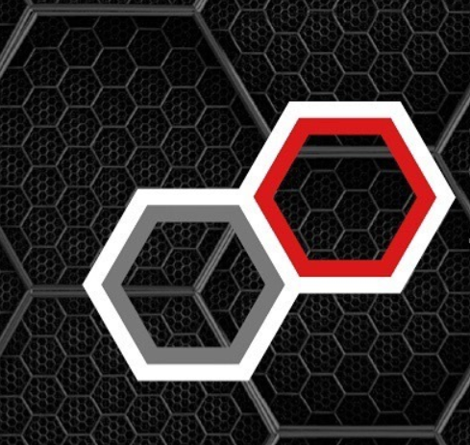
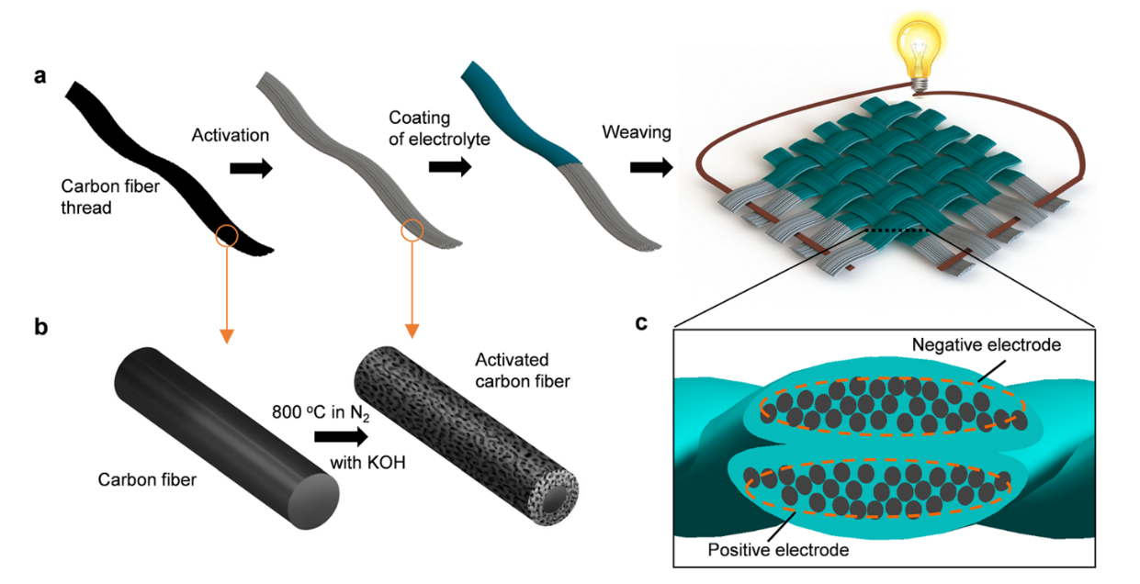
MOTIVATION
Supercapacitors experience Thermal expansion or other kinds of deformations.
Deformation changes the promising characteristics
Figure 02: Fabrication process for the load-bearing supercapacitor fabrics.[3]

Slide 5
OBJECTIVES
Mechanical performance analysis of non-porous crumpled graphene under uniaxial tensile load for different degree of crumpling.
Performance analysis of porous crumpled graphene under uniaxial tensile load for different degree of crumpling.
Comparison of strain energy due to deformation both in porous and non porous cases.
Mechanical performance analysis under uniaxial compressive test.
ME 400

Slide 6
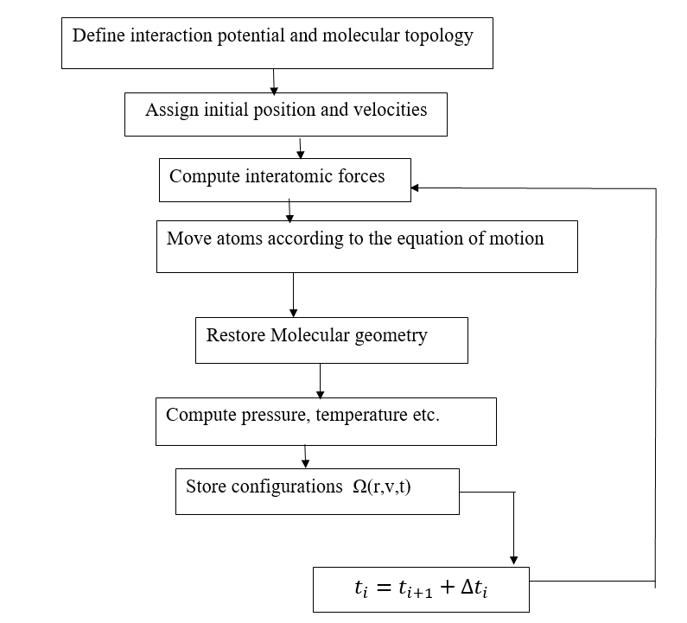
SIMULATION & METHODOLOGY
Molecular Dynamics
Platform: Large-scale Atomic/Molecular Massively Parallel Simulator (LAMMPS), OVITO
Potential: Adaptive Intermolecular Reactive Empirical Bond Order (AIREBO).

Slide 7
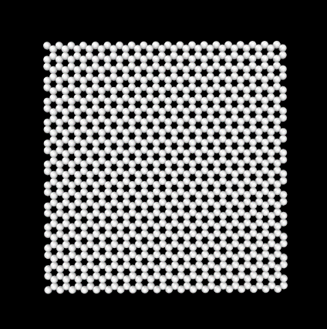
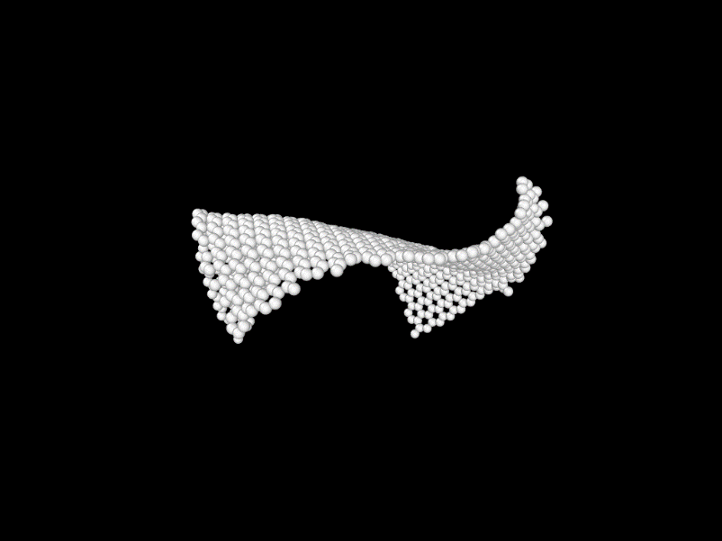
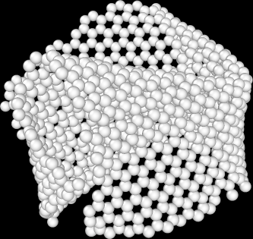
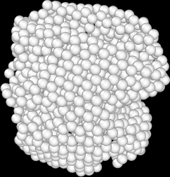
SIMULATION & METHODOLOGY
Initialization
Equilibration
Final run
Crumpling
Crumpling process
Potential: AIREBO
Size: 50Å x 50Å
Buehler et al.[2]
r =
r = 26.5 Å
r = 19.3 Å
r = 7.6 Å

Slide 8
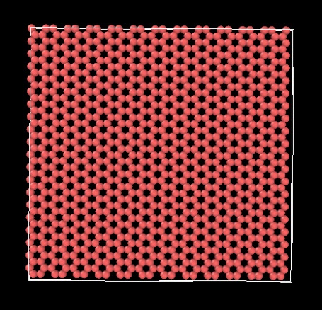
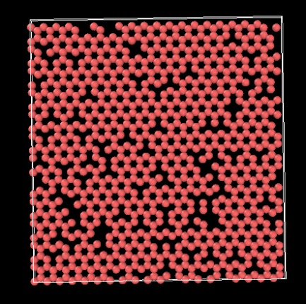
SIMULATION & METHODOLOGY
Addition of Porosity
Percentage Porosity | Number of atoms
0% | 960
5% | 912
10% | 864
20% | 768
30% | 672
0% Porosity
-Perforated graphene
-Randomly added defects[2]
10% Porosity
ME 400

Slide 9
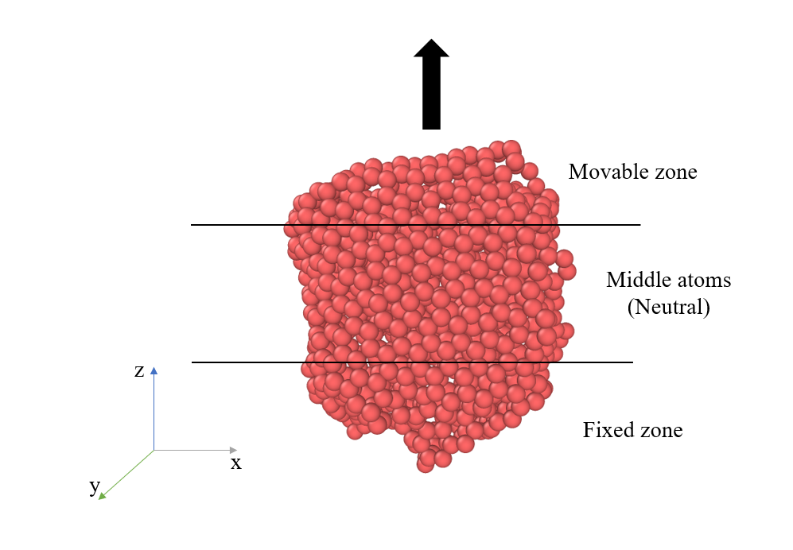
SIMULATION & METHODOLOGY
Tensile Loading
Methods:
Rescaling method
Displacement control method
Parameters:
Strain rate: 0.001 ps⁻¹ or 10⁹ s­­⁻¹
Timesteps: 0.0005ps
Relaxation: 1ps
Temperature: 300 K
Boundary Condition: p p s
y
z
Figure 03: Tensile load along y axis by displacement control method

Slide 10
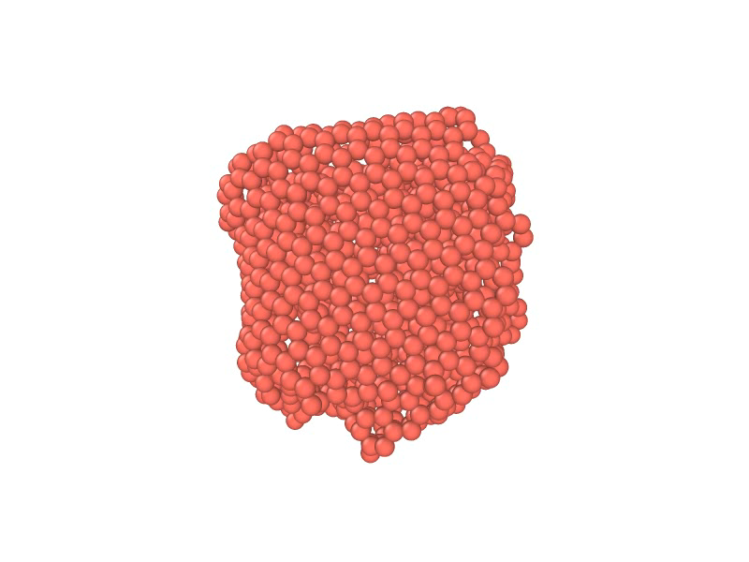
SIMULATION & METHODOLOGY
Tensile Loading
Displacement control method

Slide 11
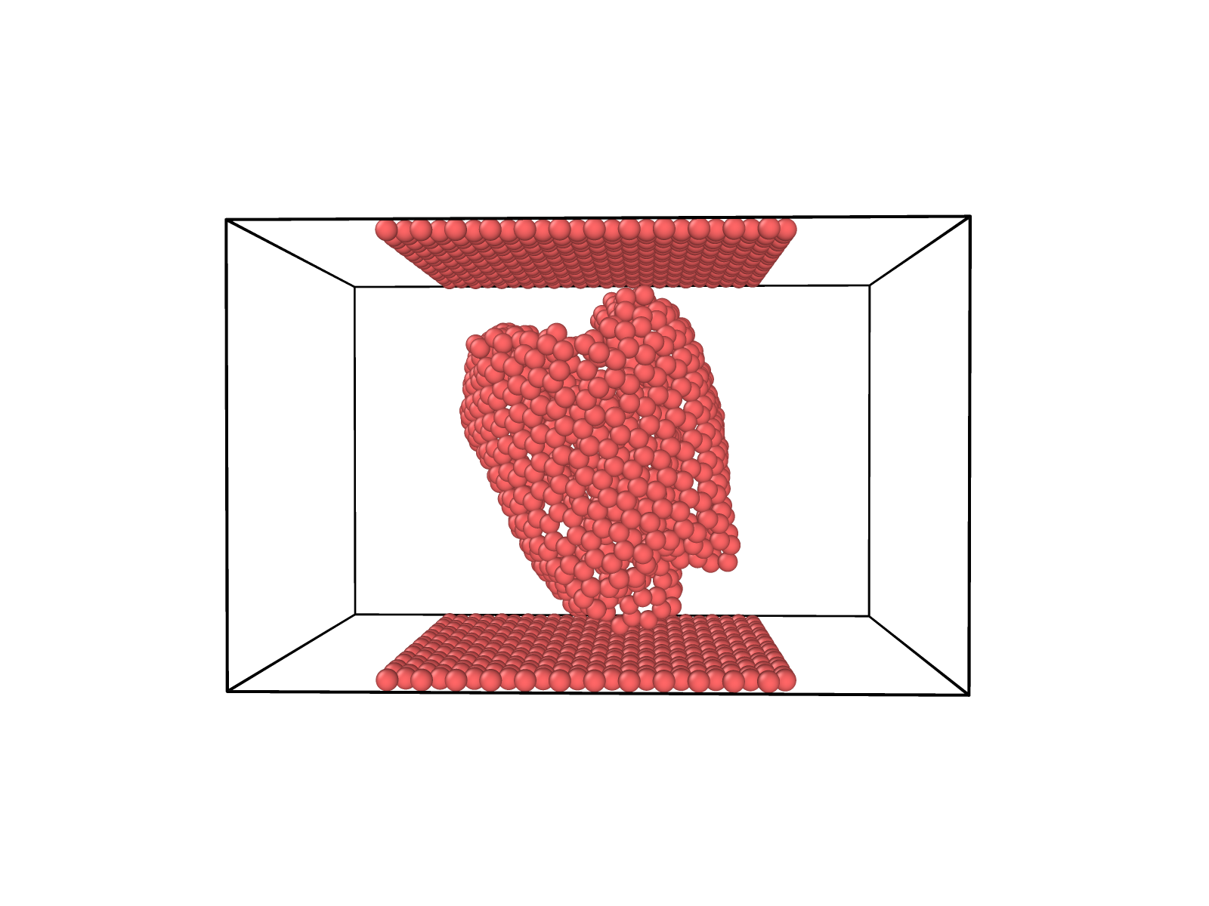
SIMULATION & METHODOLOGY
Compressive Loading and
unloading
Displacement control method
Parameters:
Strain rate: 0.02 ps⁻¹
Timesteps: 0.0002ps
Relaxation: 30ps
Temperature: 300 K
Boundary Condition: s p p
y
x
z
Figure 04: Compressive load along y axis by displacement control method

Slide 12
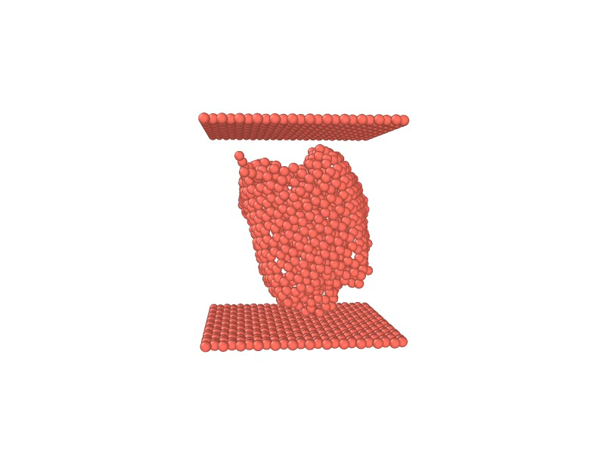
SIMULATION & METHODOLOGY
Compressive Loading
Displacement control method

Slide 13
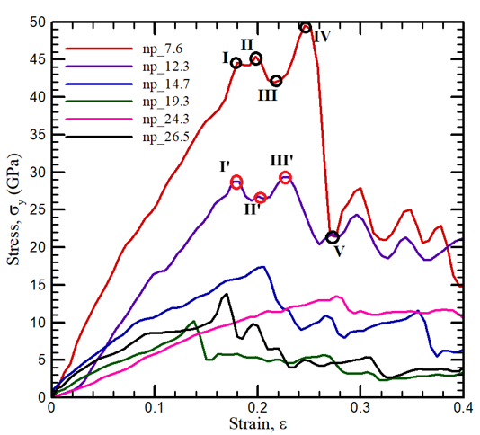
Results And Discussion
Fracture under Uniaxial Tensile Load on Non-porous CGs
Figure 05: Variation of stress as a function of strain at different levels of crumpling in graphene.

Slide 14
Results And Discussion
Fracture under Uniaxial Tensile Load on Porous CGs
Figure 06: Variation of stress as a function of strain for flat graphene at different levels of porosity.

Slide 15
Results And Discussion
Fracture under Uniaxial Tensile Load on Porous CGs
Figure 07: Variation of stress with strain in case of a CG with 19.3 Å at different porosity level.

Slide 16
Results And Discussion
Fracture under Uniaxial Tensile Load on Porous CGs
Figure 08: Variation of stress with strain in case of a CG with 14.7 Å at different porosity level.

Slide 17
Results And Discussion
Fracture under Uniaxial Tensile Load on Porous CGs
Figure 09: Variation of stress with strain in case of a CG with 7.6 Å at different porosity level.
Critical Radius
Porosity , Stress
Porosity ,Stress

Slide 18
Results And Discussion
Crumpling Radius, Å | Fracture Toughness, GPa
 | Non porous Graphene | With 10% porosity | With 20% porosity
Infinite (Flat) | 120 | 50 | 30
24.3 | 13.7 | 8.8 | 7.2
19.3 | 10.5 | 3.5 | 7
14.7 | 18 | 16 | 3.5
12.3 | 29.5 | 23 | 14
7.6 | 49.5 | 26 | 18
ME 400

Slide 19
Results And Discussion
Stiffness under Uniaxial Tensile Load
Figure 10: Variation in Elastic Modulus with change in crumpling radius.
Stiffness does not vary with crumpling radius with more porosity.
Significant Carbon-Carbon bond has been lost.

Slide 20
Results And Discussion
Stiffness under Uniaxial Tensile Load
Figure 11: Variation of elastic modulus with % of porosity in electrode at different degree of crumpling.
With larger crumpling radii, the effect of porosity on the elastic modulus is less important.

Slide 21
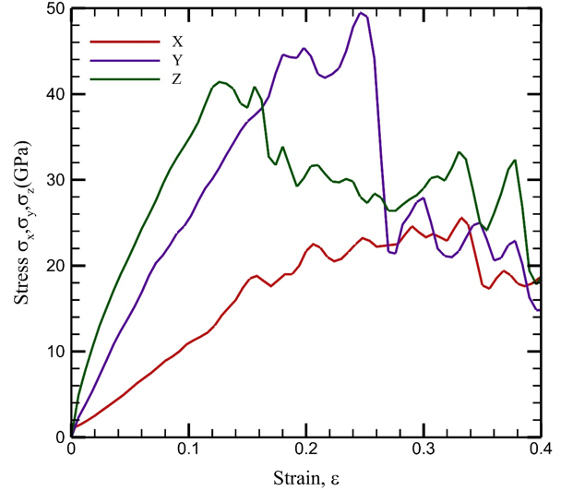
Results And Discussion
Tensile Load along x, y and z directions
Figure 12: Variation of stress with strain for 7.6 Å CG for uniaxial tension added towards x, y and z directions.
Due to presence of symmetry loading in y and z direction shows better performance.

Slide 22
Results And Discussion
Tensile Load along x, y and z directions

Slide 23
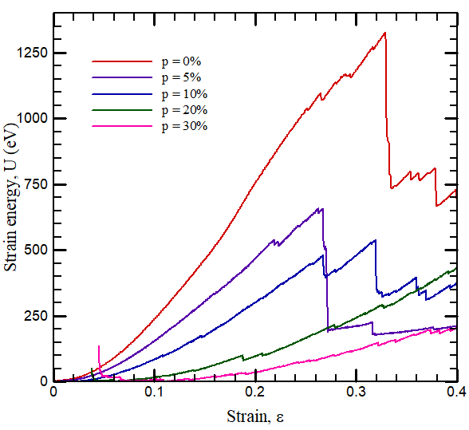
Results And Discussion
Strain Energy under Uniaxial Tensile Load
Figure 12 : Variation of strain energy in Flat graphene with applied strain at different degree of porosity.

Slide 24
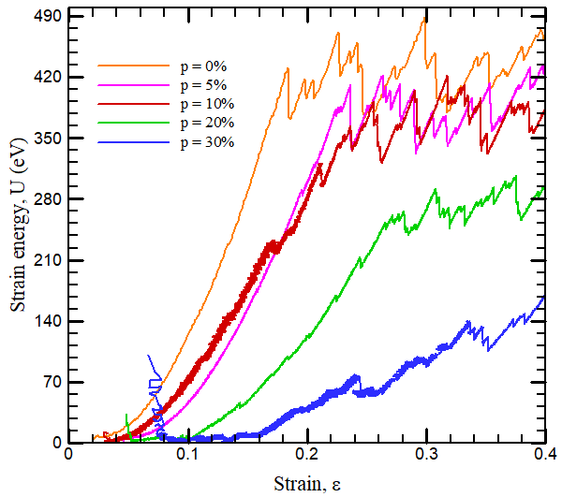
Results And Discussion
Strain Energy under Uniaxial Tensile Load
Figure 13: Variation of strain energy in crumpled graphene with applied strain at different degree of porosity with crumpling radius 12.3 Å.

Slide 25
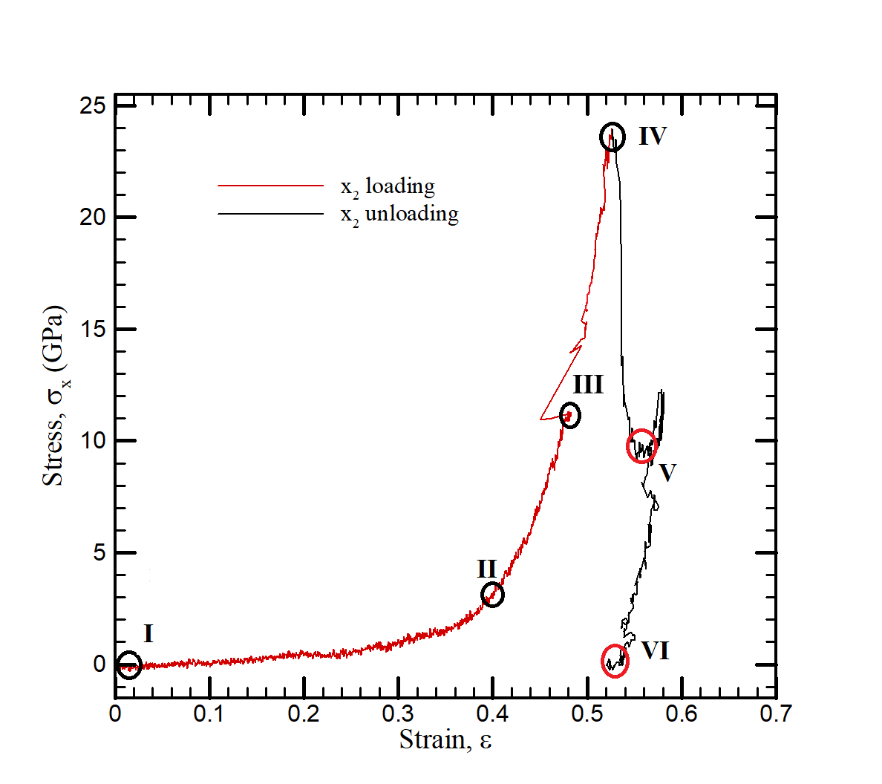
Results And Discussion
Compressive Load along x-axis
Figure 14: Variation of stress as a function of strain under uniaxial compressive load along x direction.

Slide 26
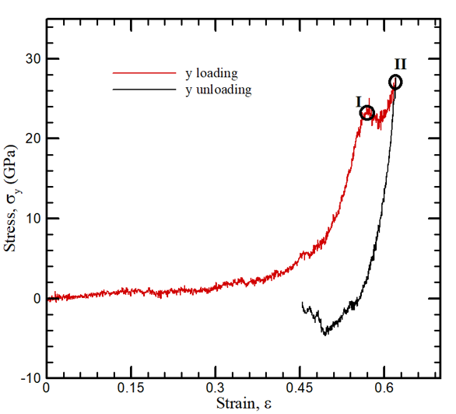
Results And Discussion
Compressive Load along y-axis
Figure 15: Variation of stress with strain under uniaxial compressive loading along y direction.

Slide 27
Validation
Figure 16: Variation of stress with applying strain along the armchair direction on a flat graphene.[4]

Slide 28
Validation
Table 1: Young's modulus values as reported in articles.
References | Methods | Elastic Modulus, GPa
Arroyo and Belytschko[5] | Continuum models | 694
Kudin and Scuseria[6] | Ab initio and Quantum | 1021
Ni and Bu[7] | MD simulations | 1100
Tsai and Tu[8] | MD simulations | 912
Georgantzinos et al. [9] | Finite element method | 1367
Li and Chou[10] | Structural molecular mechanics | 1033
Lee et al.[11] | Experiment | 1033
Yupeng and Pan[12] | Experiment | 891
Present study | MD simulation | 835

Slide 29
Conclusion
Crumpling initially decreases the fracture toughness, elastic modulus as well as the strain energy of crumpled graphene up to a crumpling radius of 19.3 Å, beyond which it becomes more stress-resistant with additional crumpling.
Porosity has an adverse effect on these mechanical parameters. Nevertheless, the negative impacts of porosity due to higher crumpling levels i.e., lower radius, can be partially mitigated within a specific range.
Shape of the crumpled graphene considered has great impact on its mechanical behavior.
CG deforms plastically under compressive loading and retains its deformed shape after unloading, depending on its morphology.

Slide 30
Future Recommendation
Analysis with a larger graphene sheet.
The effect of incremental strain can be observed to increase the scope of the study.
The effect of compressive loading on porous CG can be an interesting field to explore.
Composite materials with improved mechanical properties by embedding metallic nanoparticles (such as Ni, Cu).

Slide 31
Thank You

Slide 32
Appendix
Equations

Slide 33
Appendix
References
1. Roberts, M., et al., Continuum Plate Theory and Atomistic Modeling to Find the Flexural Rigidity of a Graphene Sheet Interacting with a Substrate. Journal of Nanotechnology, 2010. 2010.
Buehler, S., Packing efficiency and accessible surface area of crumpled graphene. Phys. Rev. B, 2011. 84.
Shen, C., et al., Wearable woven supercapacitor fabrics with high energy density and load-bearing capability. Scientific Reports, 2017. 7.
Dewapriya, N., A.S. Phani, and N. Rajapakse, Influence of temperature and free edges on the mechanical properties of graphene. Modelling and Simulation in Materials Science and Engineering, 2013. 21: p. 065017
Arroyo, M., Finite Crystal elasticiy of carbon nanotubes based on the exponential Cauchy-Born rule. Phys. Rev. B, 2004. 69.
Kudin, K., G. Scuseria, and B. Yakobson, C2F, BN, and C nanoshell elasticity from ab initio computations. Physical Review B, 2001. 64: p. 235406.

Slide 34
Appendix
References
6. Ni, Z., et al., Anisotropic mechanical properties of graphene sheets from molecular dynamics. Physica B-condensed Matter - PHYSICA B, 2010. 405: p. 1301-1306.
Tsai, J.-L. and J.-F. Tu, Characterizing mechanical properties of graphite using molecular dynamics simulation. Materials & Design, 2010. 31: p. 194–199.
Georgantzinos, S.K., G. Giannopoulos, and N.K. Anifantis, Numerical investigation of elastic mechanical properties of graphene structures. Materials and Design, 2010. 31: p. 4646-4654.
Li, C. and T.-W. Chou, A structural mechanics approach for the analysis of carbon nanotubes. International Journal of Solids and Structures, 2003. 40: p. 2487-2499.
Lee, C., et al., Measurement of the Elastic Properties and Intrinsic Strength of Monolayer Graphene. Science (New York, N.Y.), 2008. 321: p. 385-8.
Zhang, Y. and C. Pan, Measurements of mechanical properties and number of layers of graphene from nano-indentation. Diamond and Related Materials, 2012. 24: p. 1–5.

Slide 35
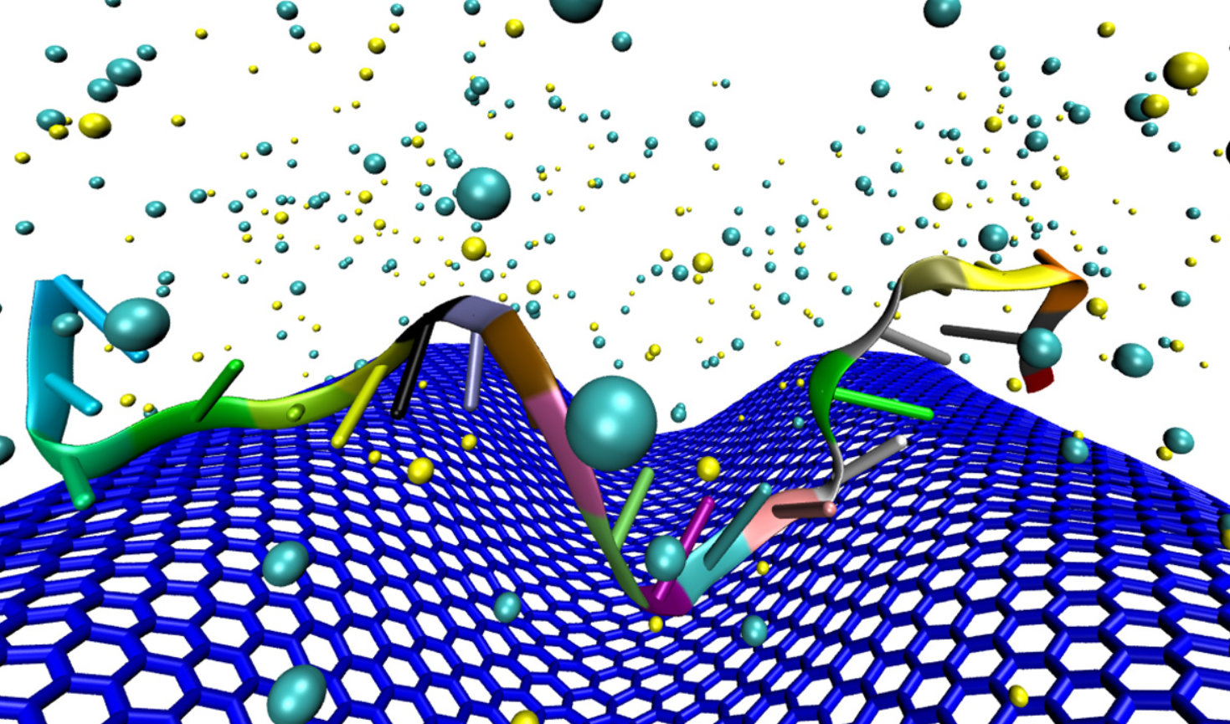
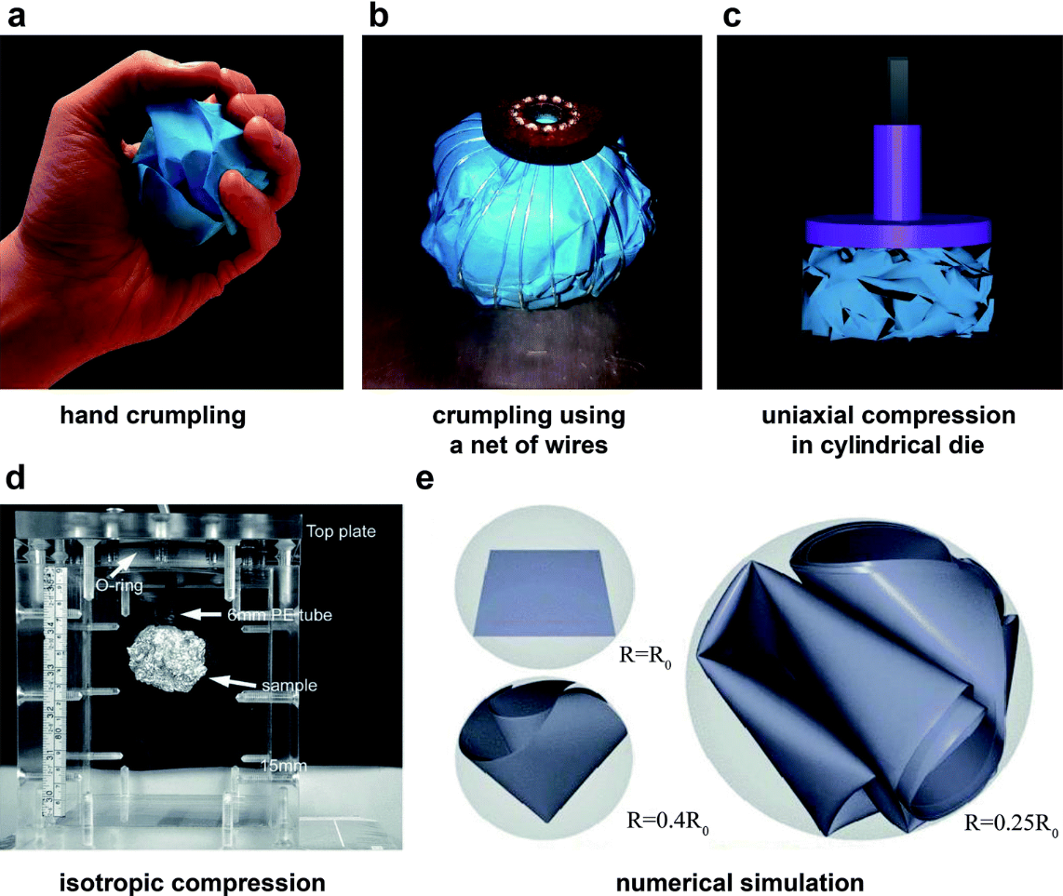
Appendix
Figure06: Different crumpling method.
Figure: Crumpled Graphene.
Source: Wikipedia

Slide 36
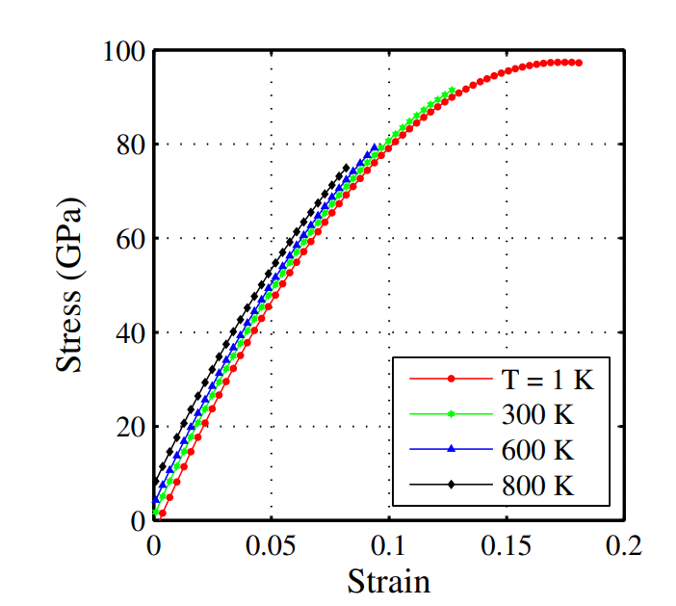
Appendix
Figure: Stress strain curve
[Dewapriya et al. 2008]
Source: Wikipedia

Slide 37
Appendix
Graphene synthesis
Mechanical exfoliation
Chemical vapor deposition
Epitaxial growth
Crumpled Graphene synthesis
Aerosol spray drying method
Hydrothermal method
Thermal reduction of graphene oxide method
Mechanical method
Source: Wikipedia

Slide 38
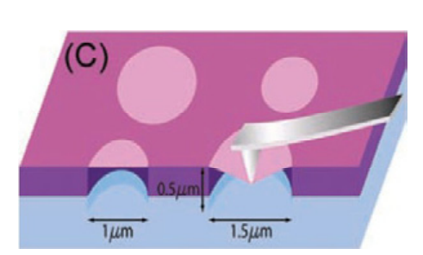
Appendix
Figure: Nanoindentation of suspended graphene membrane.
[Lee et al. 2008]
Source: Wikipedia

Slide 39
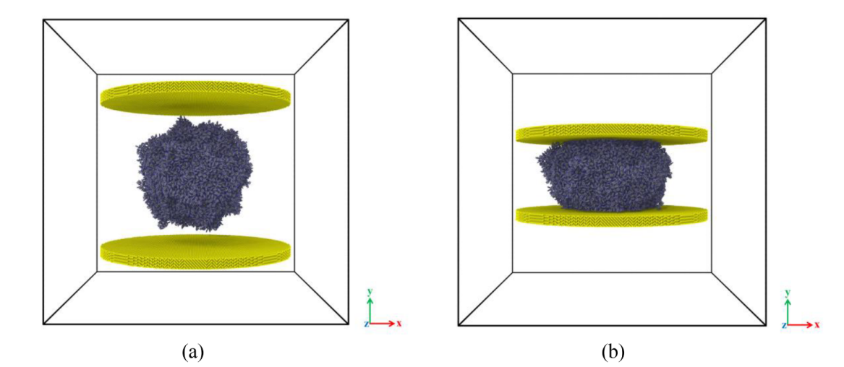
Appendix
Figure: Compression of polystyrene.
[Akbari et al. 2020]
Source: Wikipedia

Slide 40
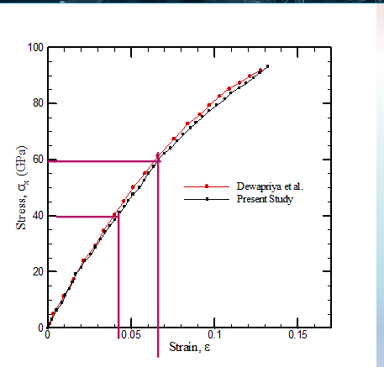
Appendix
Source: Wikipedia

